Slide 1
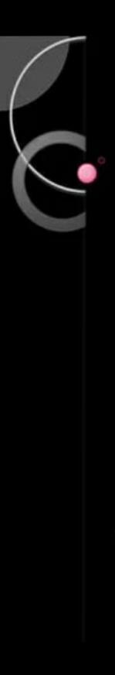
Contents
Execution
Analysing
Comparing
Cropping
Account creation
Merging
ATCVM.cpp

Slide 2
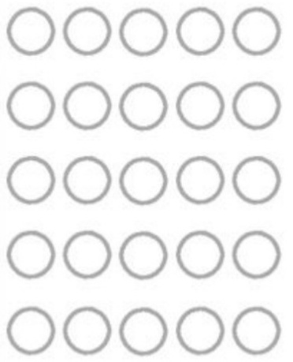
Sample format:
Size: 2018 * 1012
BANK NAME
__/__/____
Funds
Multiples
1,00,00,000
10,00,000
1,00,000
10,000
1,000
Payee :___________________
A/C no : 123456666
Payee fingerprint
Payer fingerprint
OTHER BANK DETAILS

Slide 3
Account creation :
Int128_t pre_deposit = 1000000000; char name1[]=“JACK”,name2[]=“JAMES”, name3[]=“HENRY”,name4[]=“OLIVIA”; pp[100].set(name1,12345666,pre_deposit); pp[101].set(name2,12345777,pre_deposit); pp[102].set(name3,12345888,pre_deposit); pp[103].set(name4,12345999,pre_deposit);
Account’s are created in that way with the pre deposit’s
Check program ATCVM.cpp for that,
Program line : from 368.

Slide 4
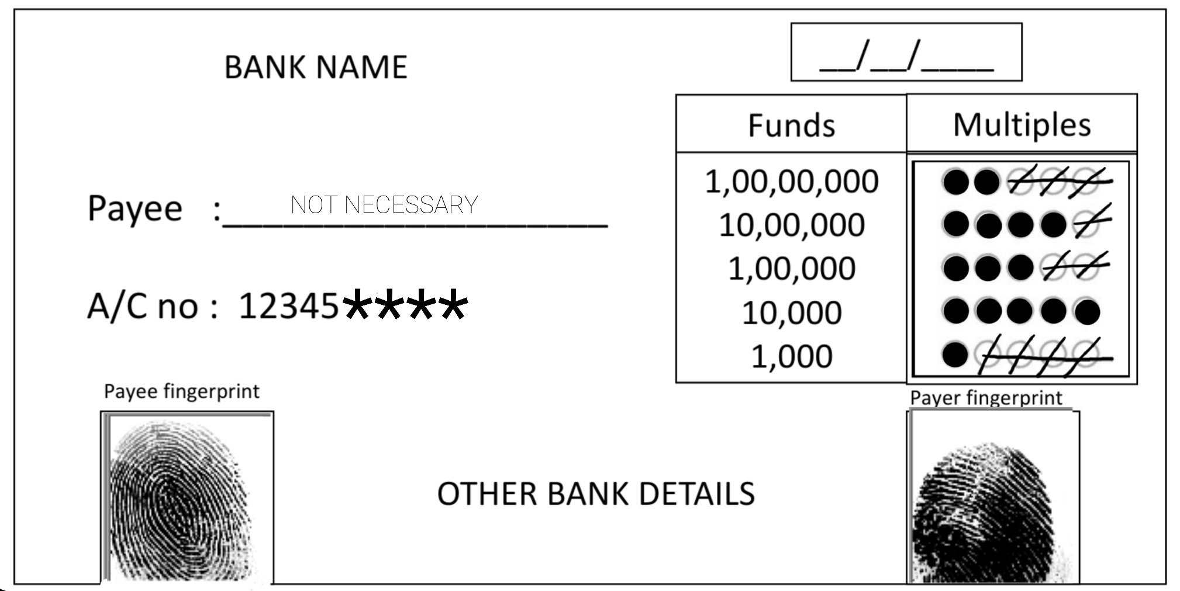
For Example:
Let’s work with this copy.
Path:~/Automated-Cheque-Processing/Prototype/upload_doc
When the program ask you to upload document
Upload in that path with the similar name of “sample.jpg”

Slide 5

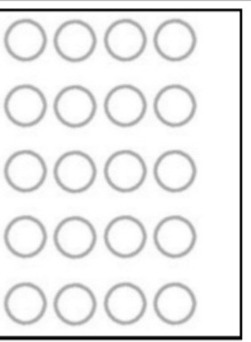
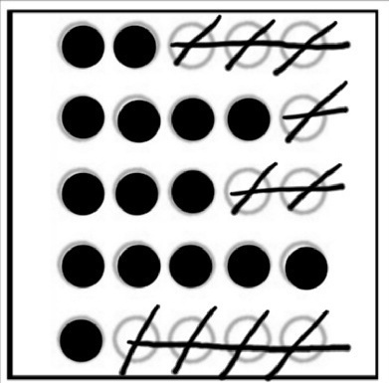





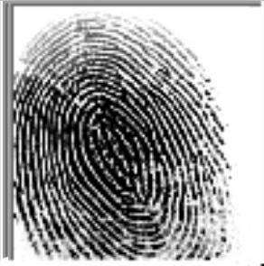
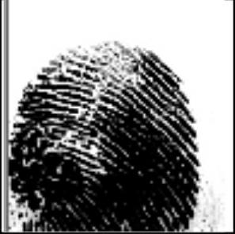
CROPPING :
Pre cropped img by name a. shri.jpg and b. mali.jpg
a.
b.
2. OMR cropped & then divided into 5 sections
c.
g.
f.
h.
e.
d.
Path : ~/Automated-Cheque-Processing/Prototype/src/omr_generator
Left side and right side fingerprint impressions are cropped.
Γ.
Ω.

Slide 6
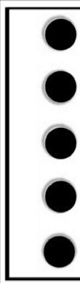
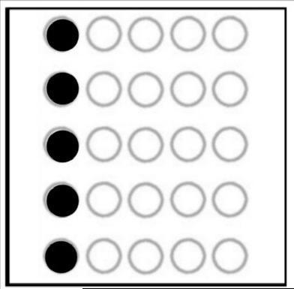
Path : ~/Automated-Cheque-Processing/Prototype/src/fingerprint
MERGING :
3. Then 'a’ and ‘d’ are merged.
i.
After that step, i. & b. Are merged
j.
Path : ~/Automated-Cheque-Processing/Prototype/src/merge_img

Slide 7
ANALYSING :
4. Now the 'j’ omr is analysed With omr grading
technique.
Marked bubbles omit as 1,
Unmarked bubbles or out of the bubble range omit as 0 .
1st bubble’s row result, Is stored in crore.txt file
2nd bubble’s row result, Is stored in tenlakh.txt file
3rd bubble’s row result, Is stored in lakh.txt file
4th bubble’s row result, Is stored in tenthous.txt file
5th bubble’s row result, Is stored in thous.txt file
Path : ~/Automated-Cheque-Processing/Prototype/src/funds
After that, those results are read by program and Stored into it, And every time it is incremented by ‘0’ or ‘1’, when it collect’s the data from those file’s again.
The same process is again applied, to the divided section’s ‘e’, ‘f’, ‘g’

Slide 8
As soon as it complete’s , then the total incremented of crore, ten lakh, Lakh, ten thousand, thousand are multiplied with their respective funds(it is shown in sample image).
NOTE : 1 small error, The python program output 1
for unmarked bubbles row too, it works when a single
bubbled out of five marked
COMPARING :
5. Γ and Ω fingerprints are compared with the fingerprint database.
After successful comparison,
Funds from respective detected accounts
are credited and debited.
Path : ~/Automated-Cheque-Processing/Prototype/src/comp_fins

Slide 9
EXECUTION :
6. At the end The user can know his updated balance.
And exit from the window
The message to the payer will be sent through sms or mail, Which is not accessible by payee.
Just to show you I have added that option.
Note : Main things almost covered, two simple Things not included.
1. Date verification which is simple can be done while builting prototype.
2. Last fingerprint Impression verification.
relevant data like diagram, flowchart of working mode and why you need to
choose are project? are in the main File
“auto cheque PPT updated.pptx” which you had checked in 1st round.

Slide 10
Technologies :
Used in this prototype
C/C++ programming
Python
Note : I couldn't Add Azure services in the prototype and could not make
video, Because I don’t have sophisticated device’s due to personal
family issues, I had only one Android phone, I have did my best.
Now you can check my program and you will understand that we can use the Azure services to those two database’s,
And much more.
Thank you

Slide 11
Ideas:
We can make it as “One machine multiple bank access”
Generating passive income when other bank cheque’s inserted.

Slide 12
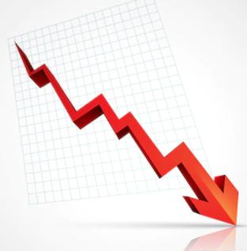

Your faithful
Hariom
Mali

